Slide 1
PUSL 2026 - Computer Networks
Lecture 7 – Segmentations & Network Topologies
Chamara Disanayake
Senior Lecturer
Department of Network and Security

Slide 2
Network Designing Progress
Requirements identification
User, Application, Device, Network, Other requirements
Operational Requirements
RMA
Requirement Analysis
Requirement mapping, Flow Analysis, Capacity Planning

Slide 3

Security and Manageability as a Requirement
Network security is a main concern in computer networks.
Network Security protects network and data from breaches, intrusions and other threats.
Detection/monitoring and containment of security attacks are very important, and the network should be facilitated.
Manageability
Manageability is the ability of managing the network in efficient and effective to achieve RMA
Simplicity of the network enhance the manageability and complex large networks are less manageable
How the manageability and security integrated to network design?

Slide 4
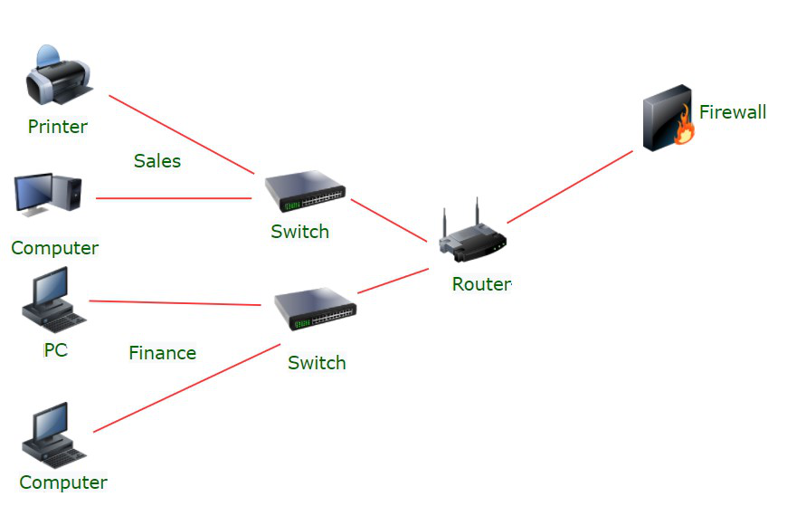
Network Segmentation
Divide and Conquer
Network segmentation is a networking architectural design that divides a network into multiple segments (subnets) with each functioning as a smaller, individual network
Segmentation divides a computer network into smaller parts.
Segmentation works by controlling the flow of traffic within the network.
Traffic can be restricted in or to segments based on location, along with where traffic can and cannot flow. Traffic flow can also be limited by traffic type, source and destination.
It improves network performance and security.
Similar terms: network segregation, network partitioning, and network isolation.

Slide 5
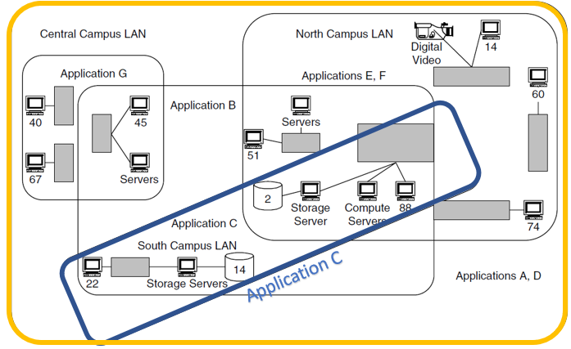
How Network Segmentation Works
Network segmentation divides a network into multiple zones and manages each zone, or segment, individually.
Segmentation is done based on the functions, by data types or by user levels.
Applying traffic protocols to manage what traffic passes through the segment and what is not allowed.
Applying security protocols to each zone to manage security and compliance.
Network segments are designated with their own dedicated hardware to wall each other off and only allow credentialed users to access the system.
Rules are built into network configurations to determine how users, services and devices on subnetworks can interconnect with each other.

Slide 6
Types of Segmentation
There are two types of network segmentation: Physical and Virtual.
Physical segmentation uses dedicated hardware to build segments.
One must plug different groups of devices into separate switches.
Physical segmentation is the most secure method, it is also the most difficult to manage.
Also known as perimeter-based segmentation, each segment needs its own internet connection, physical wiring and firewall.
This type of segmentation operates on trust, in which anything internal is trusted and anything external is not.

Slide 7
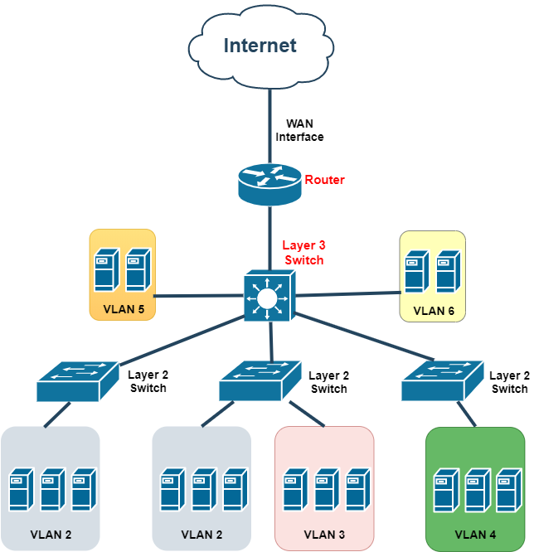
Segmentation Types - Virtual
Virtual Segmentation uses software defined perimeters to defined segments in the network.
Layer 2 Segmentation
VLAN (Virtual Local Area Networks) provides a segmentation of LAN in to separate sub networks with layer 2 devices like VLAN enabled switches.
Layer 3 segmentation
IP Subnets provides different IP networks to devices.
Layer 3 devices used to control the access and traffic.

Slide 8
Benefits of Network Segmentation
Improve operational performance
Reduces network congestion.
For example, a hospital's medical devices can be segmented from its visitor network so that medical devices are unaffected by web browsing.
Limit cyberattack damage
Improves cybersecurity by limiting how far an attack can spread (Containment).
For example, segmentation keeps a malware outbreak in one section from affecting systems in another.
Protect vulnerable devices
Stop harmful traffic from reaching devices that are unable to protect themselves from attack.
For example, a hospital's connected infusion pumps may not be designed with advanced security defenses. Network segmentation can stop harmful Internet traffic from ever reaching them.

Slide 9
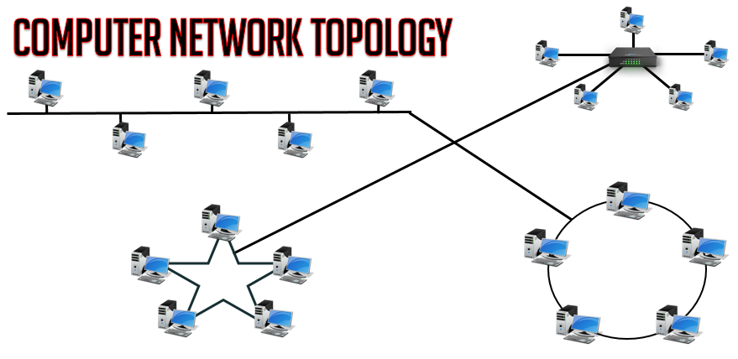
What is Network Topology
Topology: The way in which elements are interrelated or arranged.
Network Topology:
“The arrangement of a network that comprises nodes and connecting lines via sender and receiver”

Slide 10
Why Is Network Topology Important?
It is critical to have a clear understanding of network topology as it will enable you to choose the one that best suits your objectives and business requirements.
Different connectivity logics have different set of advantages and also drawbacks as well.
The choice of the right network topology can help you to:
Reduce network operational and maintenance costs,
Increase network performance,
Ensure optimal network health by the effective allocation of resources,
Locate and troubleshoot errors faster.

Slide 11
Why Different Topologies
Different Networks having different goals and connectivity:
A LAN is a shared medium that serves many DTEs (data terminal equipment) located in proximity such as in one building.
LANs use bus, ring and star
A WAN links networks that are geographically separated by long distance through switches, routers, and/or bridges.
WAN requires a different approach eg :mesh /tree
N1
N2
N3
N4
N5
N6

Slide 12
Categories of Network Topologies
There are two types of LAN topologies:
Logical
Physical
Logical topology is concerned with how messages are passed from node to node within the network. It corresponds to the media access control (MAC) protocol used in the LAN.
Having a good grasp of the logical topology is essential for effective network management and monitoring, which ensures that your network is efficient and healthy.

Slide 13
Physical Topology
Physical topology refers to the physical layout of the network.
The way in which the communication is configured and how nodes attach to the network.
It refers to the placement of the various network devices such as the routers, switches, wireless access points, computers, etc. including the method employed to connect those devices, i.e. the network cables.
Knowing the physical topology of your network is important because it helps you set up expansions, with maintenance, and for provisioning tasks.

Slide 14
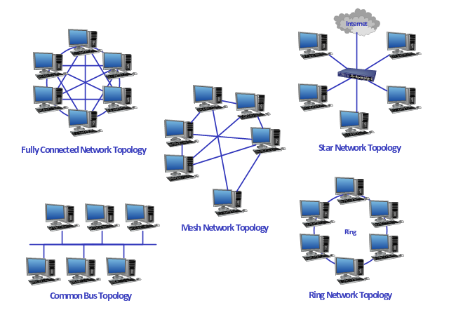
Types of Network Topologies
Star topology
Bus topology
Ring topology
Mesh topology
Tree topology
Hybrid topology

Slide 15
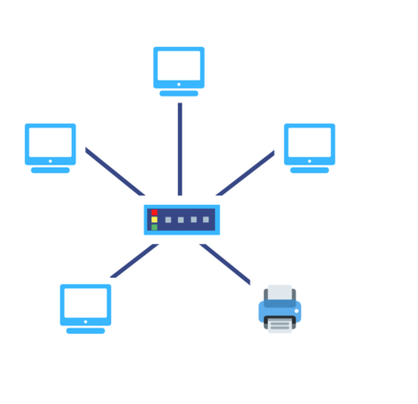
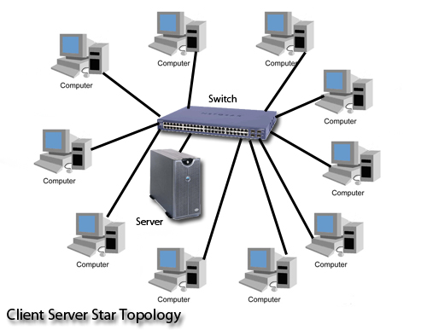
Star Topology
A star topology is the one in which each peripheral node is connected to a central hub or switch.
It is probably the most used network topology for LAN because it is considered the easiest topology to design and implement.
The central hub functions as the server for the peripheral nodes or clients.
All the network traffic passes through the central hub and this is the only requirement for the topology to be classified as a star topology;
The network doesn’t have to resemble a star in the physical arrangement.

Slide 16
Star Topology
Advantages
Each node has a dedicated connection to the network – disconnecting a single node does not bring down the rest of the nodes on the network
Network and cable administration are centralized
New nodes can be added or removed without taking the whole network offline
Disadvantages
If the concentrator (hub) on which the whole topology relies fails, the whole system will crash down.
The cost of installation is high.
Performance is based on the single concentrator i.e. hub.

Slide 17
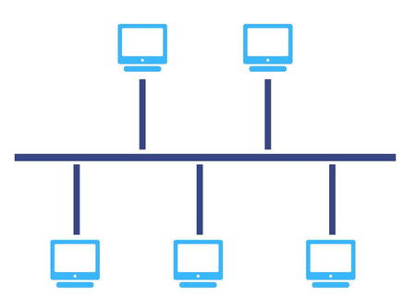
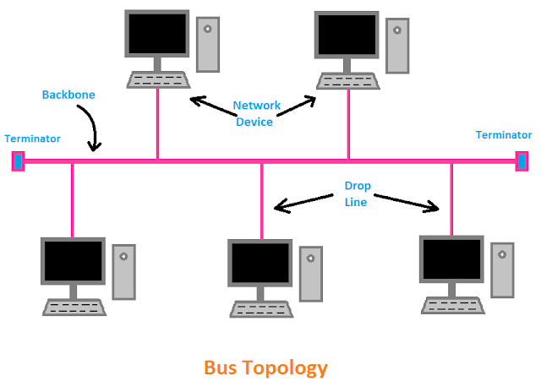
Bus Topology
It is the simplest network topology among all topologies. In this topology, all computers and networking devices are connected to a single Backbone Cable.
Both IEEE 802.3 standard and IEEE 802.4 standards and their protocols address communication over LANs with bus topologies.
Early Ethernet LAN implementations were typically physical bus architectures;
Today, most Ethernet implementations are physical stars. (However, an Ethernet shared media hub is sometimes called a “bus in a box”)

Slide 18
Bus Topology
Advantages
As it uses less cable, it is simple to build and less expensive compared to the other network topologies.
Adding new nodes to the network is easier and can be achieved by simply joining additional cables with connectors.
Disadvantages
Since the entire network depends on a single cable for data transmission, if that cable fails, the whole network will go down.
Overall maximum length of the bus is limited (10-Base-2)
Can be expensive to maintain and troubleshoot

Slide 19
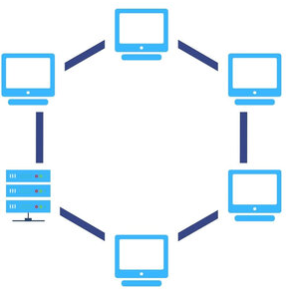
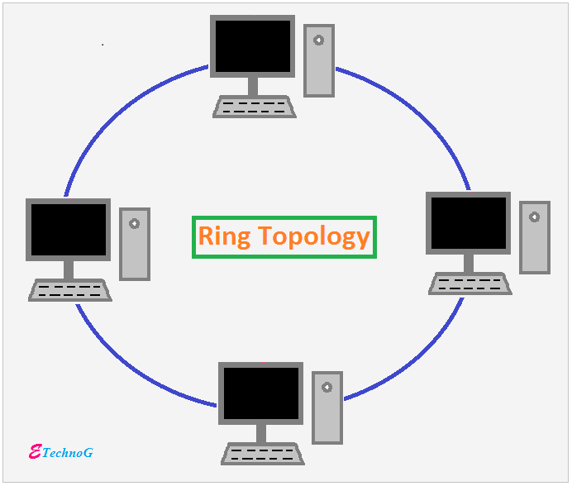
Ring Topology
The nodes are arranged in a ring or circle.
The last end of the network is connected to the first end.
Each node has exactly two peers and the data travels in one direction passing through each intermediate node on the ring until it reaches the destination node.
The transmission is unidirectional, but it can be made bidirectional by having 2 connections between each Network Node, it is called Dual Ring Topology.
In a ring topology, an electrical “token” circulates around the network. Any node that wants to transmit data has to wait until it has possession of the token.
Physical ring topologies are less common than bus or star topologies
Token ring and FDDI LANs have physical ring topologies

Slide 20
Ring Topology
Advantages
The possibility of collision is minimum in this type of topology.
Cheap to install and expand.
Disadvantages
The addition of stations in between or removal of stations can disturb the whole topology.
Less Secure
Troubleshooting is difficult

Slide 21
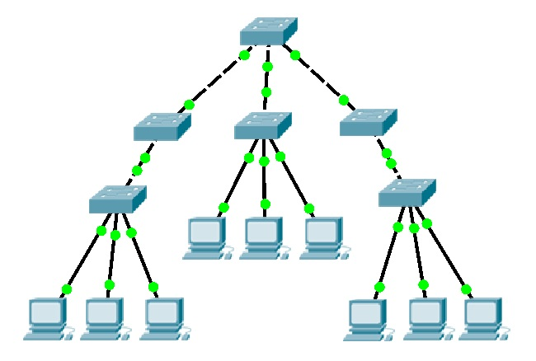
Tree Topology
The networking topology based on the hierarchy technique is called Tree Topology.
The Tree topology is best for wide area network (WAN).
Here adding and removing nodes are very easy and simple.
The administration process is also very simple. Fault can be found easily. The management of the whole network is divided into each networking devices or computer of that network.
Corporate Network mainly based on the TREE Topology which helps to maintain the management system.

Slide 22
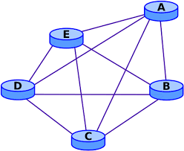
Mesh Topology
In the Mesh Topology, all devices are connected to each other so here a point-to-point connection is formed between networking devices.
In the mesh topology, data transmission is based on two techniques that are Routing and Flooding.
Mesh is also used in WAN to provide redundancy and multi-homing networks.
Mesh topology required more cables that is why the cost of this network topology is very high than other topologies.

Slide 23
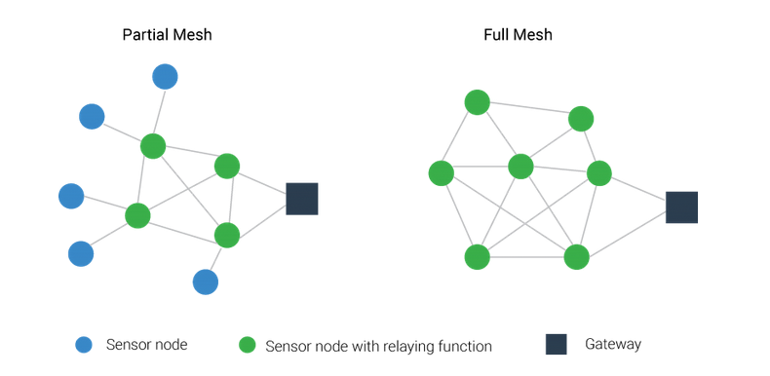
Mesh Topology
Mesh topology is classified into two types that are Partial-Mesh Topology and Full Mesh Topology.
ALOHA, FabFi networking systems are the example of Mesh Topology.
Mesh topology is widely employed to extend the coverage of short-range wireless technologies such as Zigbee, Z-Wave, WirelessHART.

Slide 24
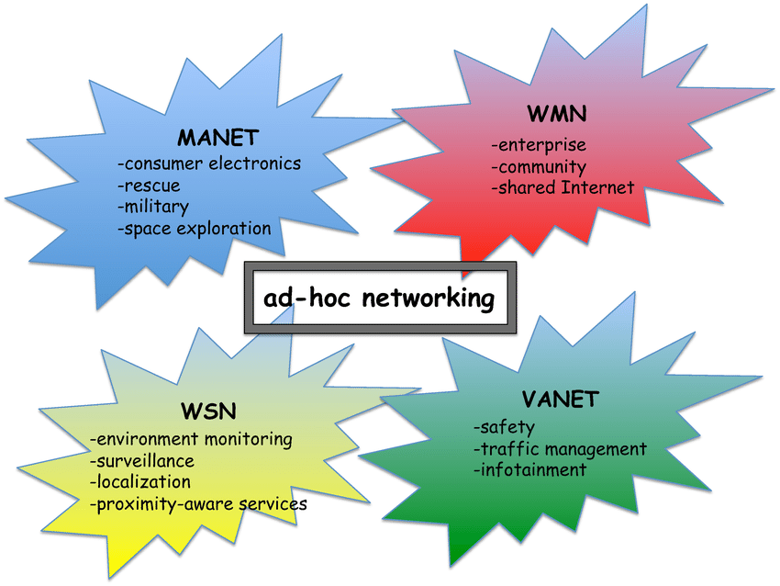
Other Topologies
The ad-hoc Mesh
Very popular with wireless networking
Currently used in beacon technology ( Bluetooth beacon - ibeacon, edistone ).
Mobile ad hoc networks (MANETs)
Vehicular ad hoc networks (VANETs)
Smart phone ad hoc networks (SPANs)
Wireless mesh networks

Slide 25
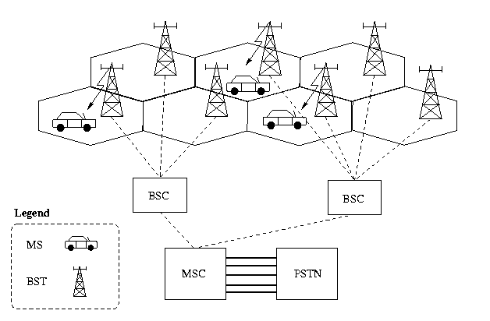
Cell Architecture ( mobile cell)
Specially design for Mobile cell network/and WiFi
Warless censor networks.
On demand usage and sheared infrastructure.

Slide 26
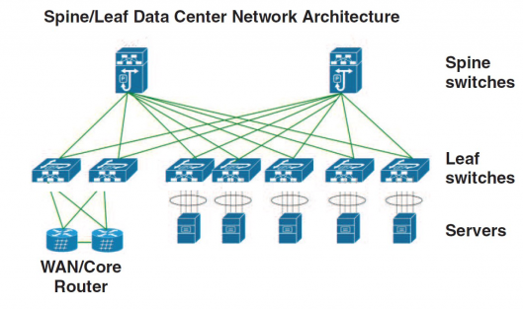
Spine and Leaf Topology
A spine-leaf architecture is data center network topology that consists of two switching layers—a spine and leaf
Used in scalable core networks.
Can be scaled to very high densities.
Used by Google and Many others who are in large Scale distributed computing industry.
mainly used in Datacenters.

Slide 27
Current Trend
The topologies are hard to differentiate as LAN ,WAN etc..
The rings are used in MAN mesh is used in special WLAN technologies.
New trends are emerging in ad-hoc and special purpose network field.
Remember if a special requirement exists it needs to be address with special design,
Generally, star networks preferred for LAN.

Slide 28
Addressing

Slide 29
Why an Address?
Everyone must be uniquely identifiable ( e.g. Name /ID numbers/passport numbers/social security /Student ID no /exam index).
The names are easy to remember for us.
Why we need different identifiers?
Network nodes needs to be identified uniquely for reliable communication.
The numbers are easy for computers especially binary, but difficult for humans.
Binary can be easily handling by logic gates ( AND/ OR/ XOR/ NAND).
There are different addressing methods used for data communication
They are used in different formats, in different conditions and by different layers

Slide 30
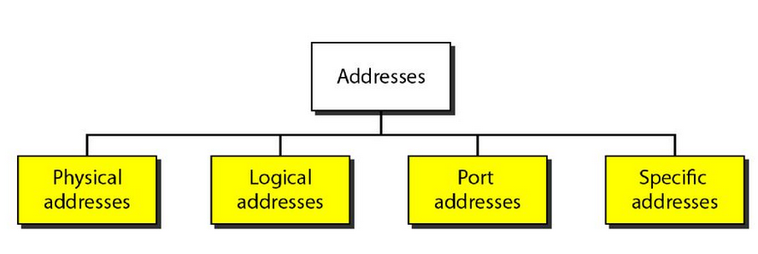
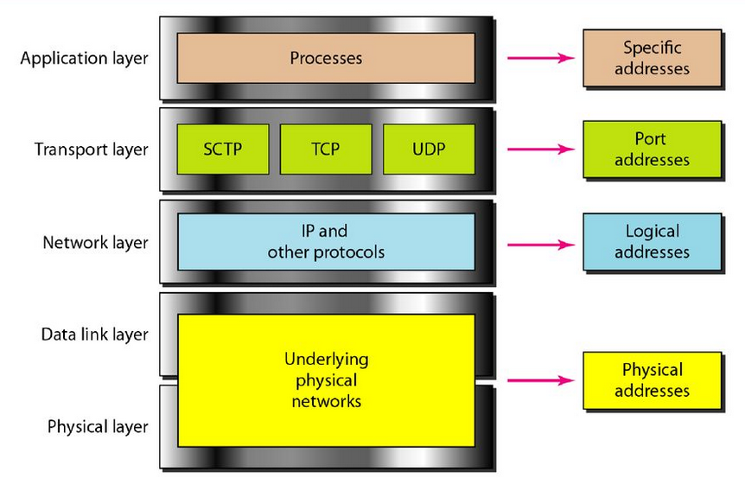
Unique Communication
Identify each other
Addressing methods
Each address method is used in different layers

Slide 31
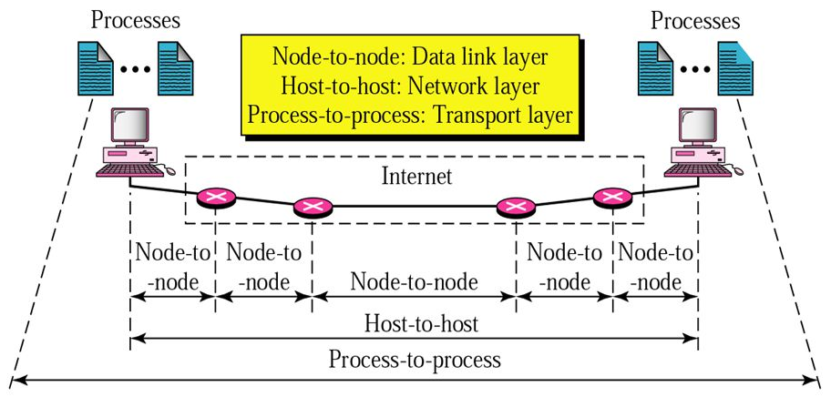
How these Addresses are Used
Data link layer – MAC addressing
Network layer – IP addressing
Transport layer – Port addressing

Slide 32
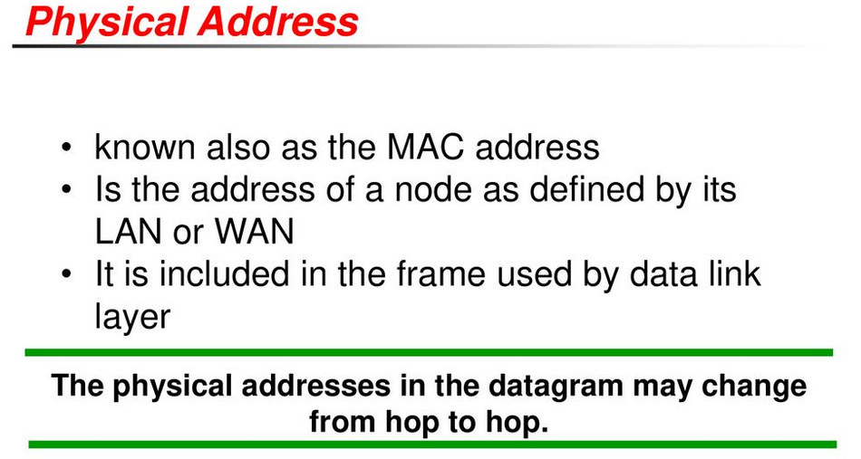
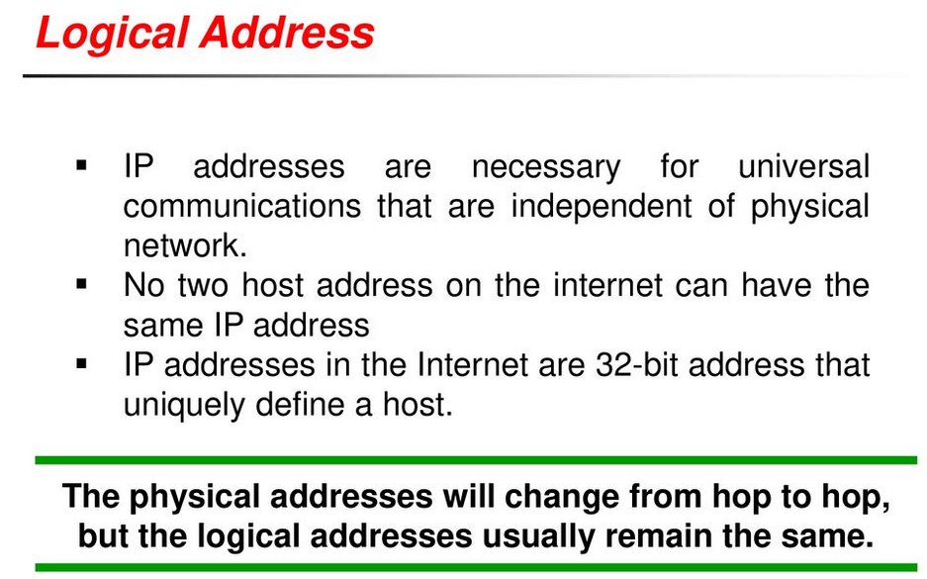
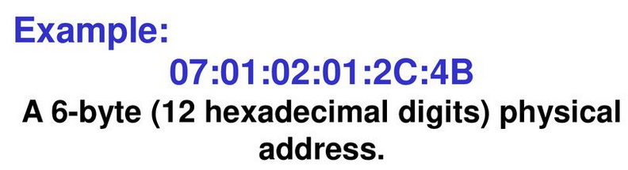
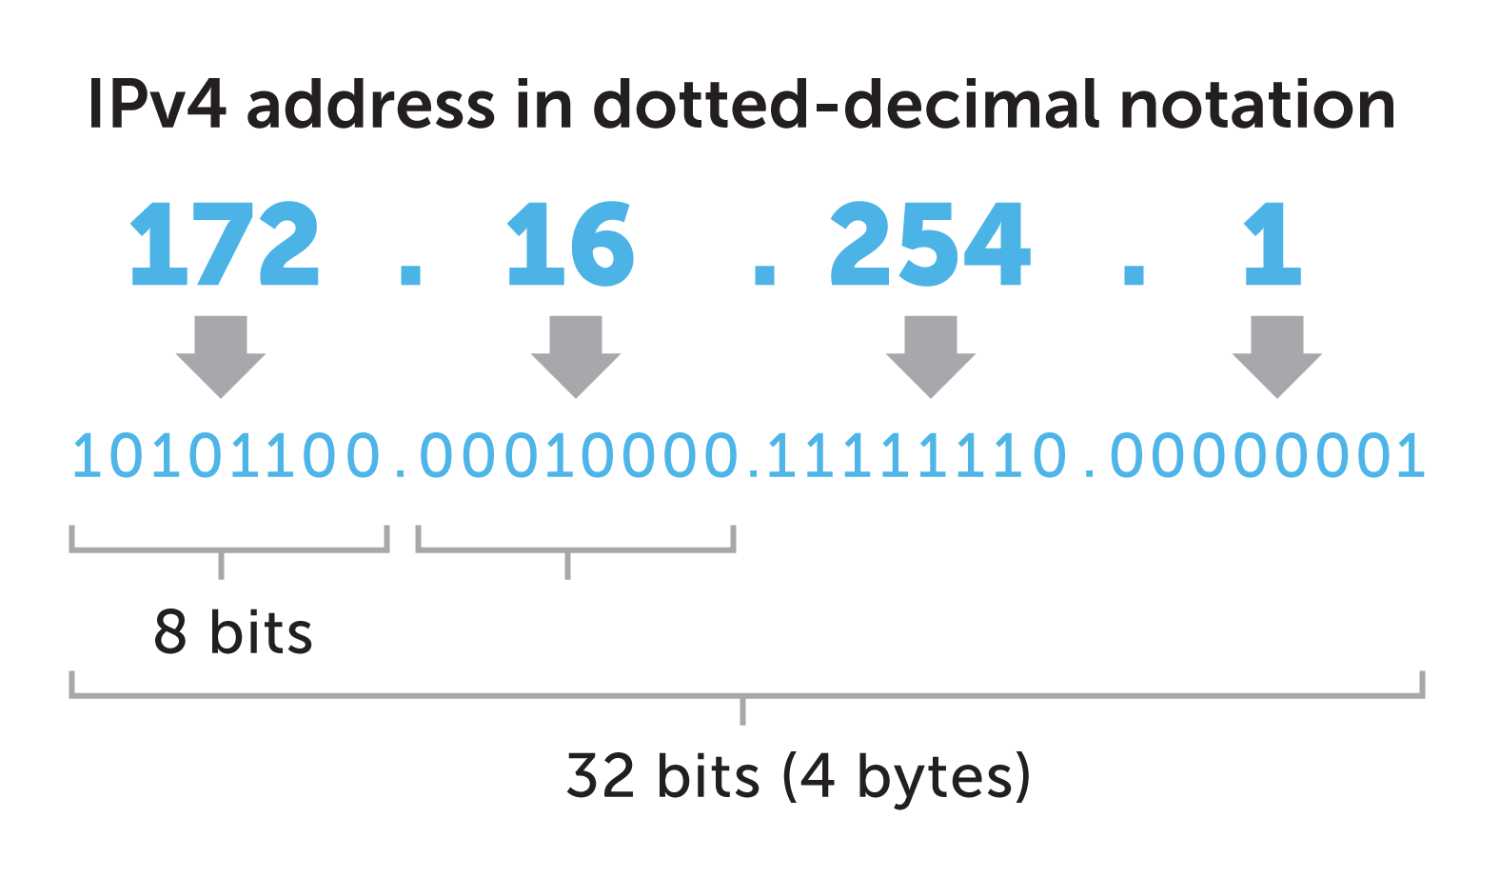
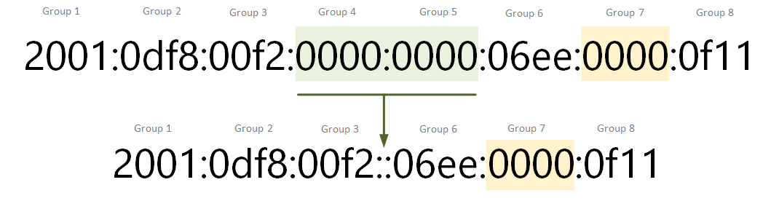
Addressing Formats
Each layer use their specific addressing in directing the communication between the end points.
Two Versions used
IPv4
IPv6

Slide 33
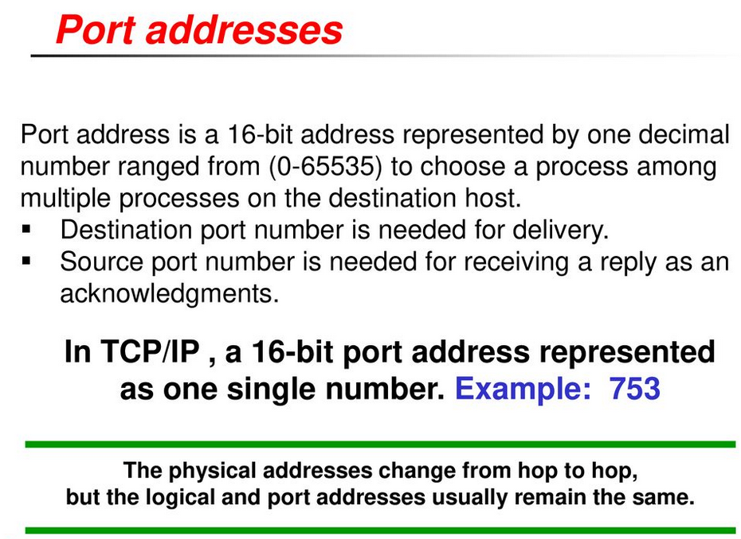
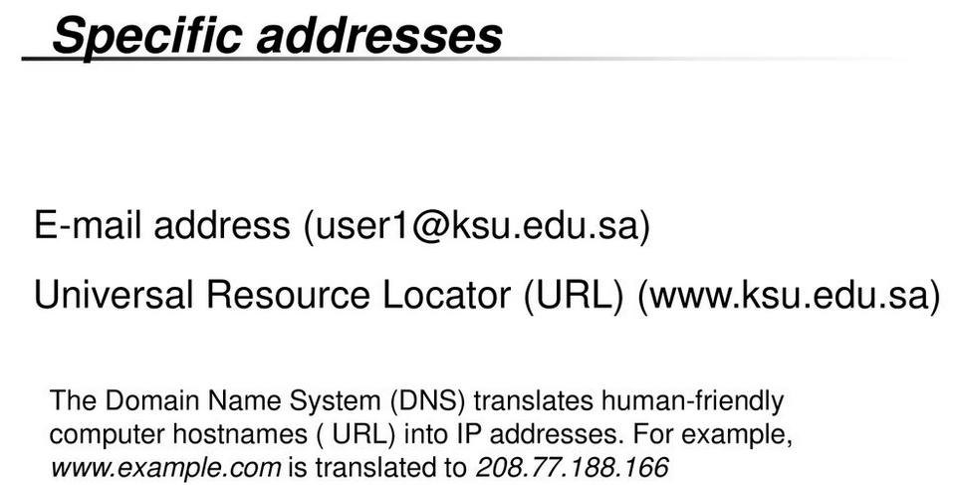
Addressing
Port Addresses and Specific Addresses

Slide 34
IPv4 Address Schema
Internet Protocol version 4 (IPv4) is the fourth version of the Internet Protocol (IP).
IPv4 uses 32-bit addresses which limits the address space to 4294967296 (232) addresses.
IPv4 was the first version deployed for production on SATNET in 1982 and on the ARPANET in January 1983.
It is still used to route most Internet traffic today – Over 60%
IPv4 is a connectionless protocol, and operates on a best-effort delivery model, in that it does not guarantee delivery, nor does it assure proper sequencing or avoidance of duplicate delivery.

Slide 35
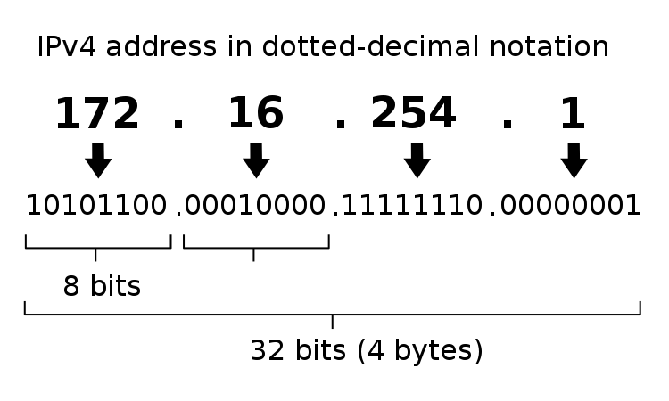
IPv4 Addressing
A binary number with 32 bits
Typically written in decimal digits, formatted as four 8-bit fields that are separated by periods(.)
Each of the four numbers can range from 0 to 255.

Slide 36
IPv4 Address Classes
Used in earlier network address assigning processes.
Address classes are defined according to “First Octet Rule”
Rule | Minimum and Maximum | Decimal Range
Class A: First bit is always 0 | 00000000 = 0 01111111 = 127 | 1 – 126 * (1.0.0.0 – 126.255.255.255)
Class B: First two bits are always 10 | 10000000 = 128 10111111 = 191 | 128 – 191 (128.0.0.0 -191.255.255.255)
Class C: First three bits are always 110 | 11000000 = 192 11011111 = 223 | 192 – 223 (192.0.0.0 –223.255.255.255)

Slide 37
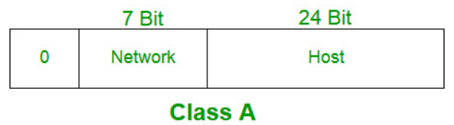
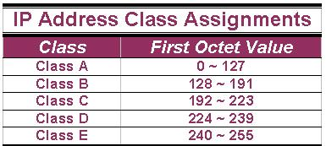
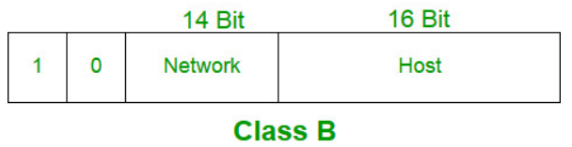
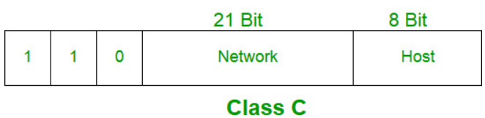
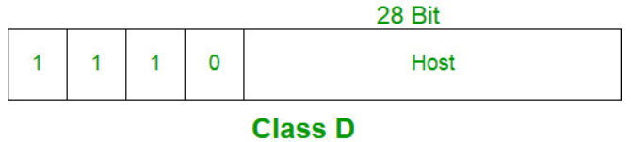
IP Address Classes
Reserve space for Private Addressing
10.0.0.0/8
172.16.0.0/12
192.168.0.0/16

Slide 38
Problems with Classful Addressing
Wasting IP addresses as no flexibility in allocating IP addressing for the organizations/networks.
Millions of class A addresses are wasted.
Many of the class B addresses are wasted, where as, the number of addresses available in class C is so small that it cannot cater to the needs of organizations.
Class D addresses are used for multicast routing and are therefore available as a single block only. Class E addresses are reserved.
As a solution to preserve IP addresses while catering the requirements of networking, Classless Interdomain Routing (CIDR) was introduced in 1993.

Slide 39
The Requirement for Breakdown of Network - Subnetting
Our requirements of networks differs form individuals/ applications / geography/ time/ etc..
They require different level of service delivery /Quality /availability/ operation and Management controls/ security /etc
When number of devices are large its difficult to manage.
Best is “Divided and Conquer”.
Needs to control the shouting ( broadcast ) in the network.
Isolation is a remedy for many problems
Subnetting is the way of deriving the network in to sub networks according to the requirement

Slide 40
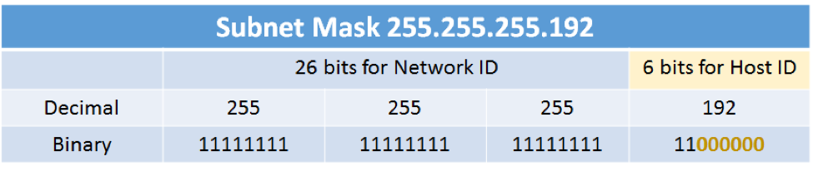
Address Masks / Subnet Mask
The address mask has ones in positions corresponding to the network and subnet numbers and zeros in the host number positions.
Eg:
172.21.0.0 is a Class B address, the last 16bits make up the host bits.
Each device or interface will be assigned a unique, host-specific address such as 172.21.35.17
The subnet mask is 11111111 11111111 00000000 00000000
Which derives → 255.255.0.0
E.g. If the host bits are 6 what is the derive the subnet mask

Slide 41
Addresses in a Subnet
In any network (or subnet) we can not use all the IP addresses for host addresses.
We lose two addresses for every network or subnet.
Network Address - One address is reserved to that of the network. This address can not be assigned to an interface
Broadcast Address – One address is reserved to address all hosts in that network or subnet. This address can not be assigned to an interface.

Slide 42
Subnet and Notation
Notation which used to Identify the IP subnets in CIDR
E.g. Subnet of 192.248.8.0/24
/24 is defined as the prefix
This means the number of bits allocated for the network
We can calculate the host bits
32-24 = 8 bits
If the prefix is given for an IP address, it is simple to derive the subnet mask and hence the network IP address.
How?

Slide 43
Network Address
Network Address is the starting address( 1st Address) of the given IP network.
It can be derived with AND operation
For each bit of the IPv4 address, performs a Boolean (logical) AND function with the corresponding bit of the subnet mask, which is a 32-bit string to derive the network address.
Example Given IP 138.101.114.250 and host part is 6 bits i.e /26

Slide 44
Exercise
IP address and a prefix is given as 192.168.2.17/28
How many IP addresses available in the subnet
What is the netmask?
What is the Network Address
What is the broadcast IP
What can be used as the gateway

Slide 45
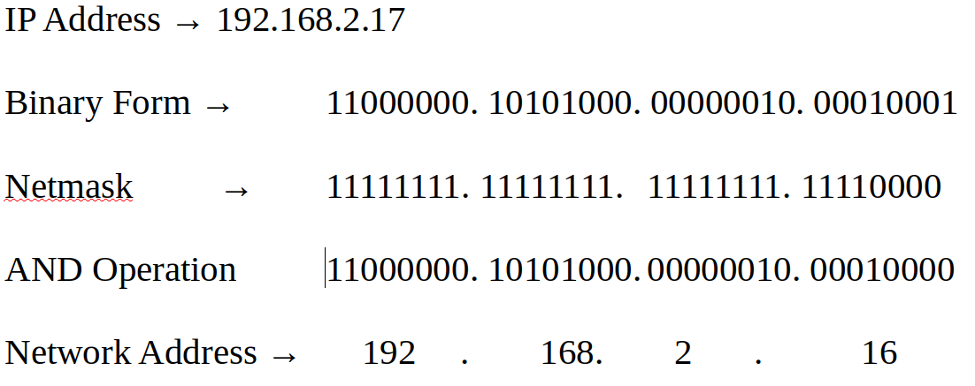
Answer
/28 is the network bits → 32-28 → 4 bits for host → 2^4 → 16 hosts can be allocated
Netmask
11111111.11111111.11111111.11110000
Network Address

Slide 46
Session Break
From 10.35 – 10.45 am

